Slide 1
File Processing

Slide 2
Introduction
Data files
Can be created, updated, and processed by C programs
Are used for permanent storage of large amounts of data
Storage of data in variables and arrays is only temporary

Slide 3
The Data Hierarchy
Data Hierarchy:
Bit – smallest data item
Value of 0 or 1
Byte – 8 bits
Used to store a character
Decimal digits, letters, and special symbols
Field – group of characters conveying meaning
Example: your name
Record – group of related fields
Represented by a struct or a class
Example: In a payroll system, a record for a particular employee that contained his/her identification number, name, address, etc.

Slide 4
The Data Hierarchy
Data Hierarchy (continued):
File – group of related records
Example: payroll file
Database – group of related files
Sally
Black
Tom
Blue
Judy
Green
File
Iris
Orange
Randy
Red
Judy
Green
Record
Judy
Field
01001010
Byte (ASCII character J)
1
Bit

Slide 5
The Data Hierarchy
Data files
Record key
Identifies a record to facilitate the retrieval of specific records from a file
Sequential file
Records typically sorted by key

Slide 6
Files and Streams
C views each file as a sequence of bytes
File ends with the end-of-file marker
Or, file ends at a specified byte
Stream created when a file is opened
Provide communication channel between files and programs
Opening a file returns a pointer to a FILE structure
Example file pointers:
stdin - standard input (keyboard)
stdout - standard output (screen)
stderr - standard error (screen)

Slide 7
Files and Streams
FILE structure
File descriptor
Index into operating system array called the open file table
File Control Block (FCB)
Found in every array element, system uses it to administer the file

Slide 8
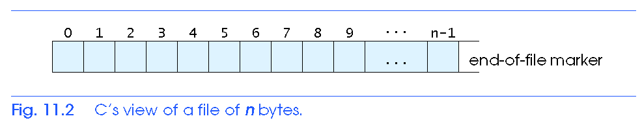
Files and Streams

Slide 9
Files and Streams
Read/Write functions in standard library
fgetc
Reads one character from a file
Takes a FILE pointer as an argument
fgetc( stdin ) equivalent to getchar()
fputc
Writes one character to a file
Takes a FILE pointer and a character to write as an argument
fputc( 'a', stdout ) equivalent to putchar( 'a' )
fgets
Reads a line from a file
fputs
Writes a line to a file
fscanf / fprintf
File processing equivalents of scanf and printf

Slide 10
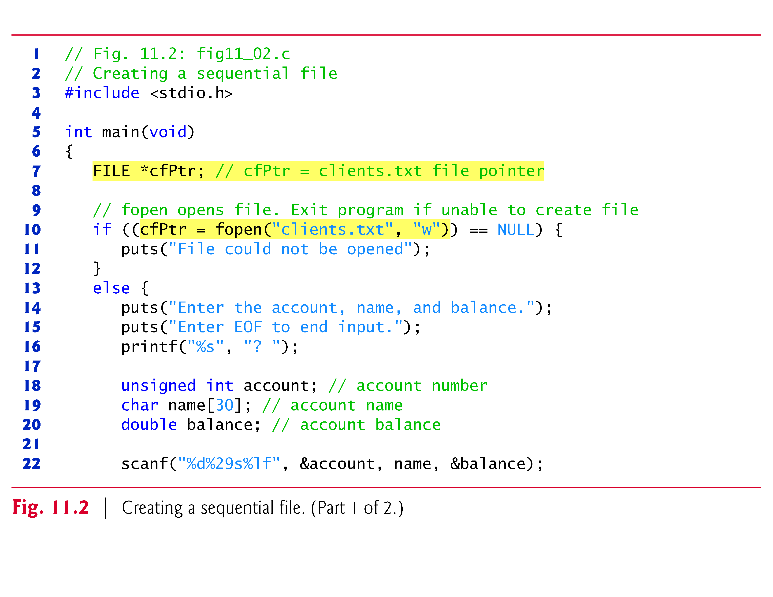
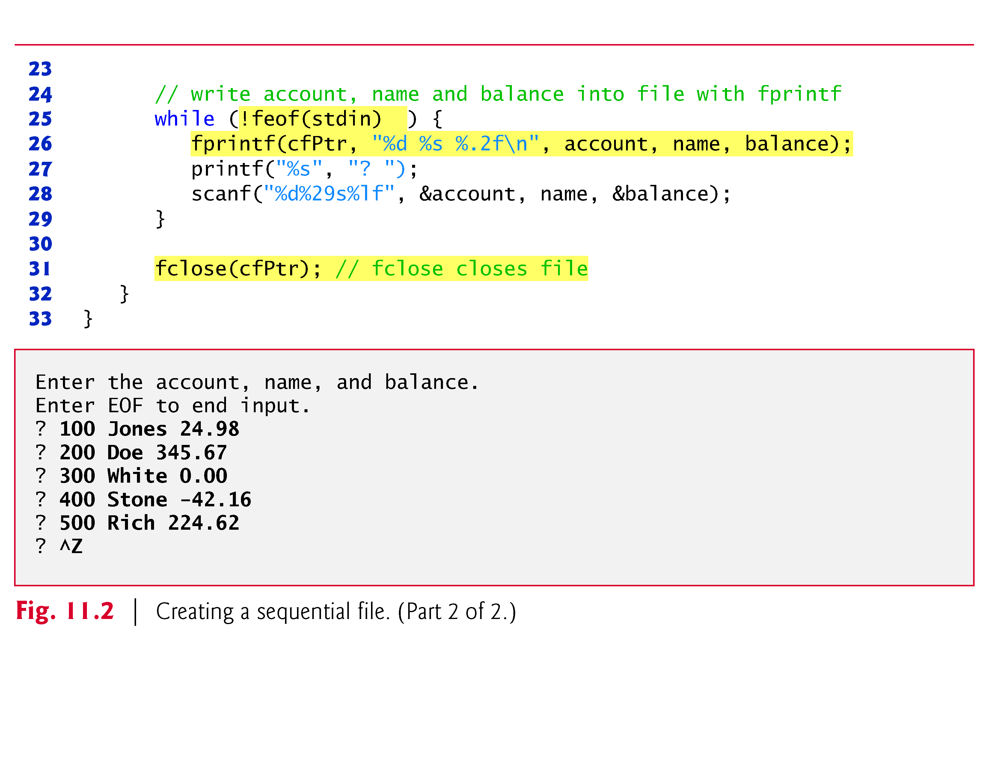

Slide 11
Creating a Sequential Access File
C imposes no file structure
No notion of records in a file
Programmer must provide file structure
Creating a File
FILE *cfPtr;
Creates a FILE pointer called cfPtr
cfPtr = fopen(“clients.dat", “w”);
Function fopen returns a FILE pointer to file specified
Takes two arguments – file to open and file open mode
If open fails, NULL returned

Slide 12
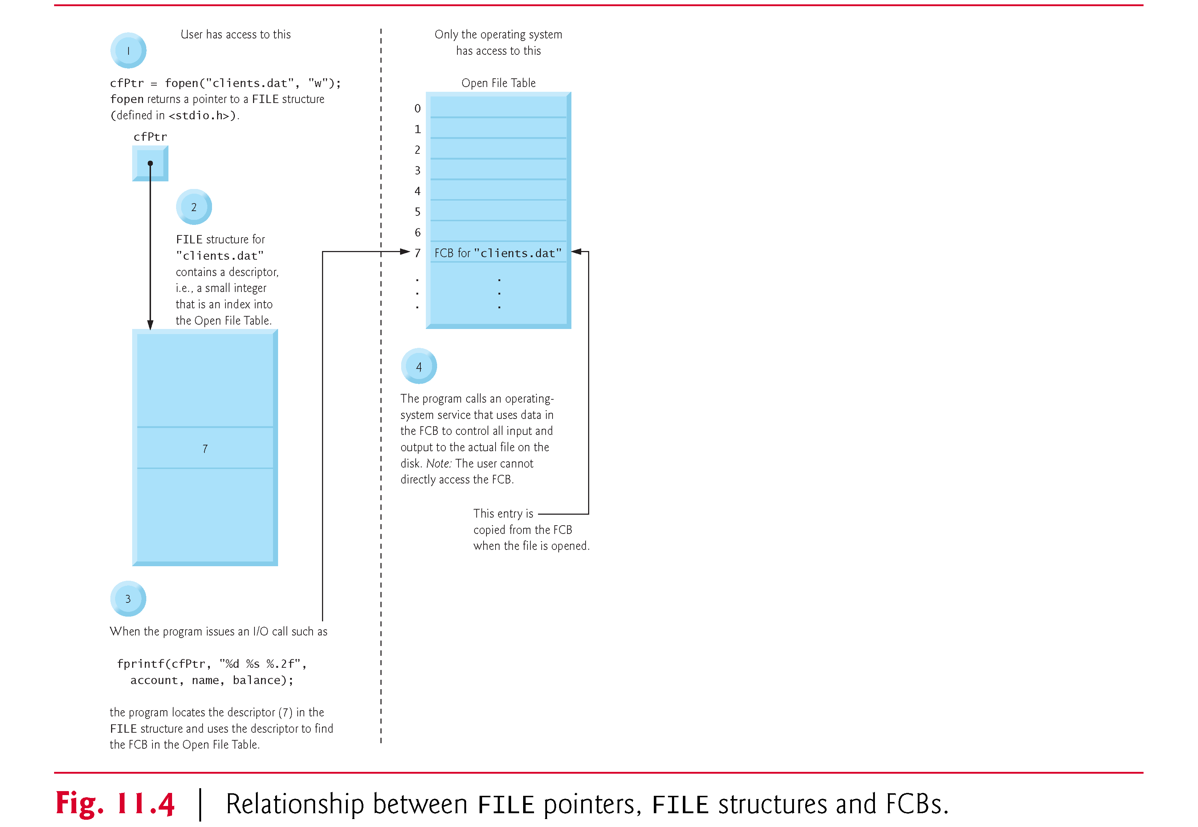

Slide 13
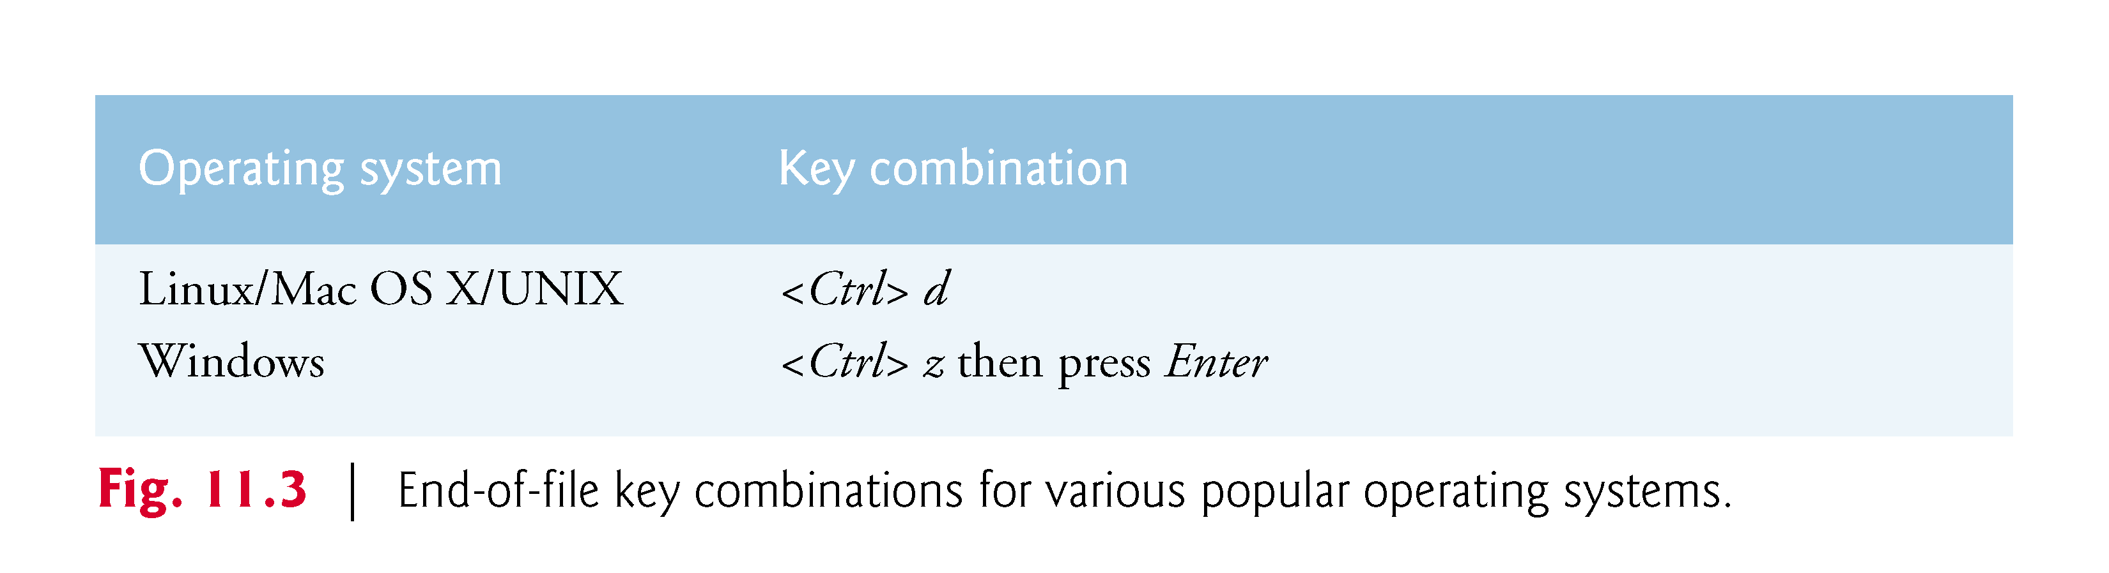
Creating a Sequential Access File

Slide 14
Creating a Sequential Access File
fprintf
Used to print to a file
Like printf, except first argument is a FILE pointer (pointer to the file you want to print in)
feof( FILE pointer )
Returns true if end-of-file indicator (no more data to process) is set for the specified file
fclose( FILE pointer )
Closes specified file
Performed automatically when program ends
Good practice to close files explicitly
Details
Programs may process no files, one file, or many files
Each file must have a unique name and should have its own pointer

Slide 15
Creating a Sequential Access File

Slide 16
Reading Data from a Sequential Access File
Reading a sequential access file
Create a FILE pointer, link it to the file to read
cfPtr = fopen( “clients.dat", "r" );
Use fscanf to read from the file
Like scanf, except first argument is a FILE pointer
fscanf( cfPtr, "%d%s%f", &accounnt, name, &balance );
Data read from beginning to end
File position pointer
Indicates number of next byte to be read / written
Not really a pointer, but an integer value (specifies byte location)
Also called byte offset
rewind( cfPtr )
Repositions file position pointer to beginning of file (byte 0)

Slide 17
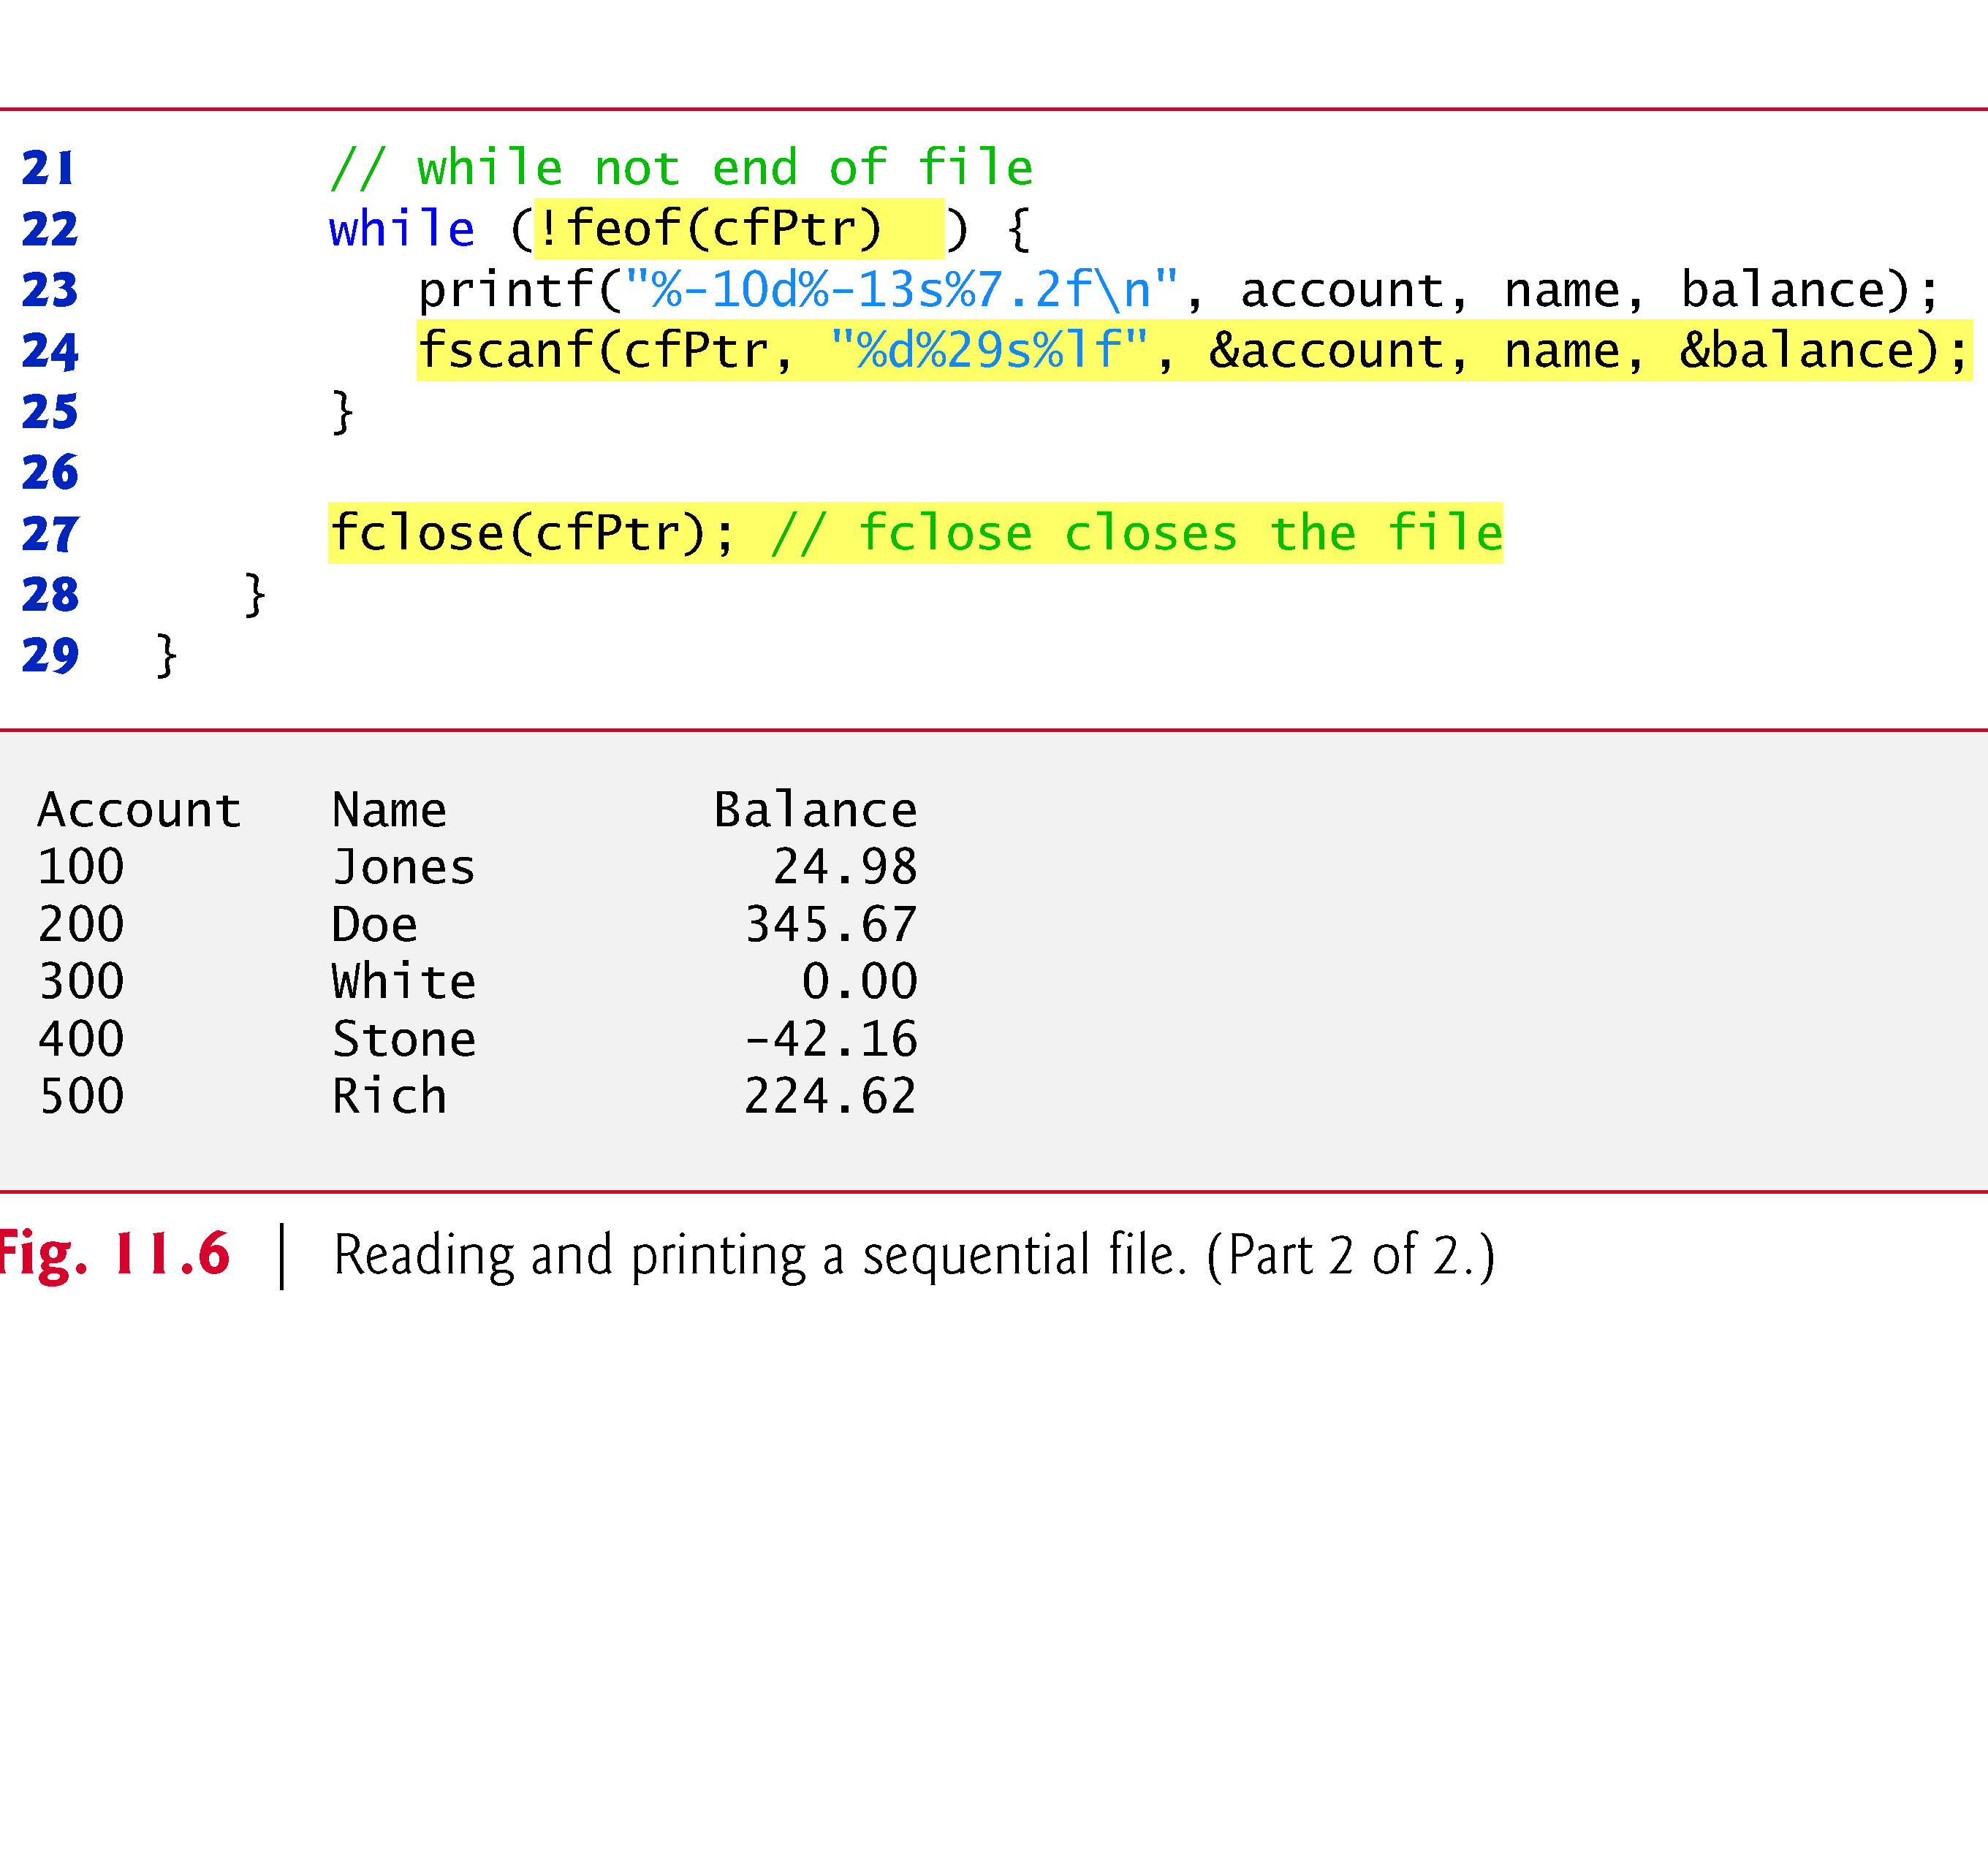
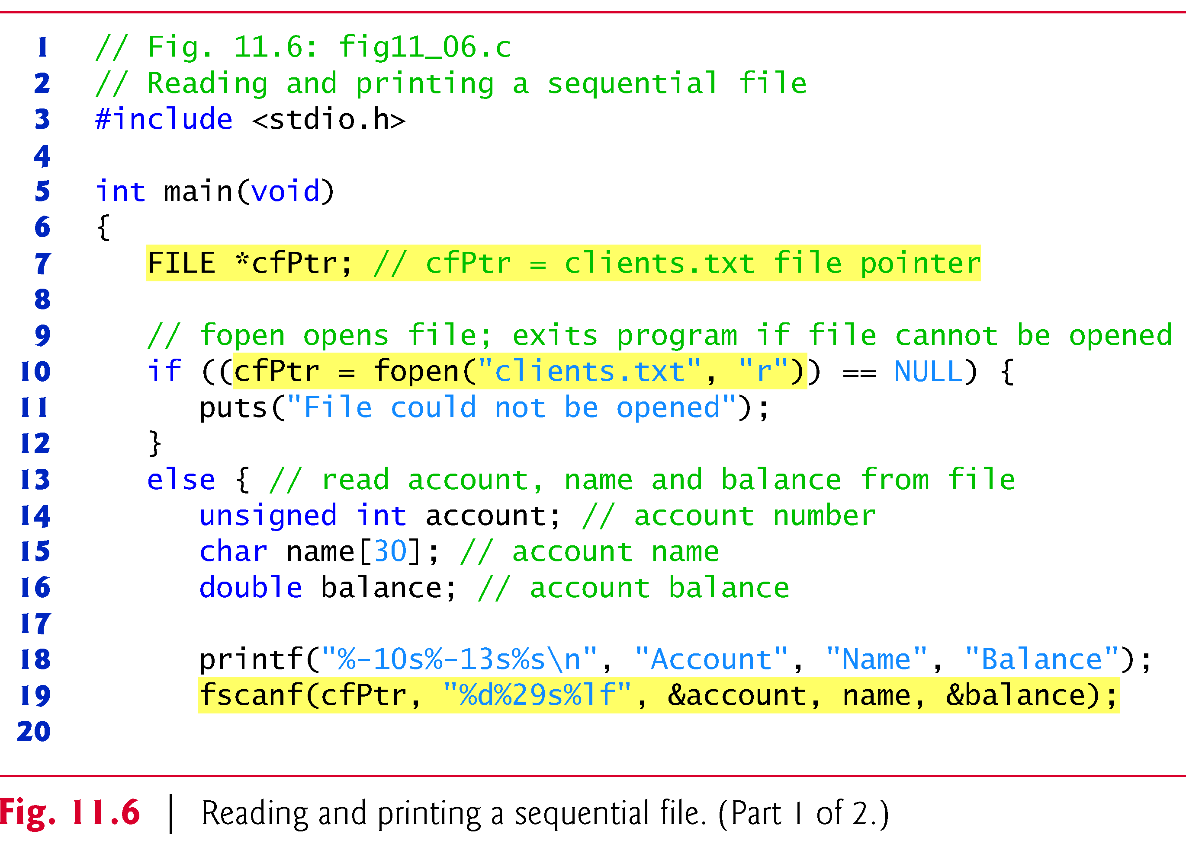

Slide 18
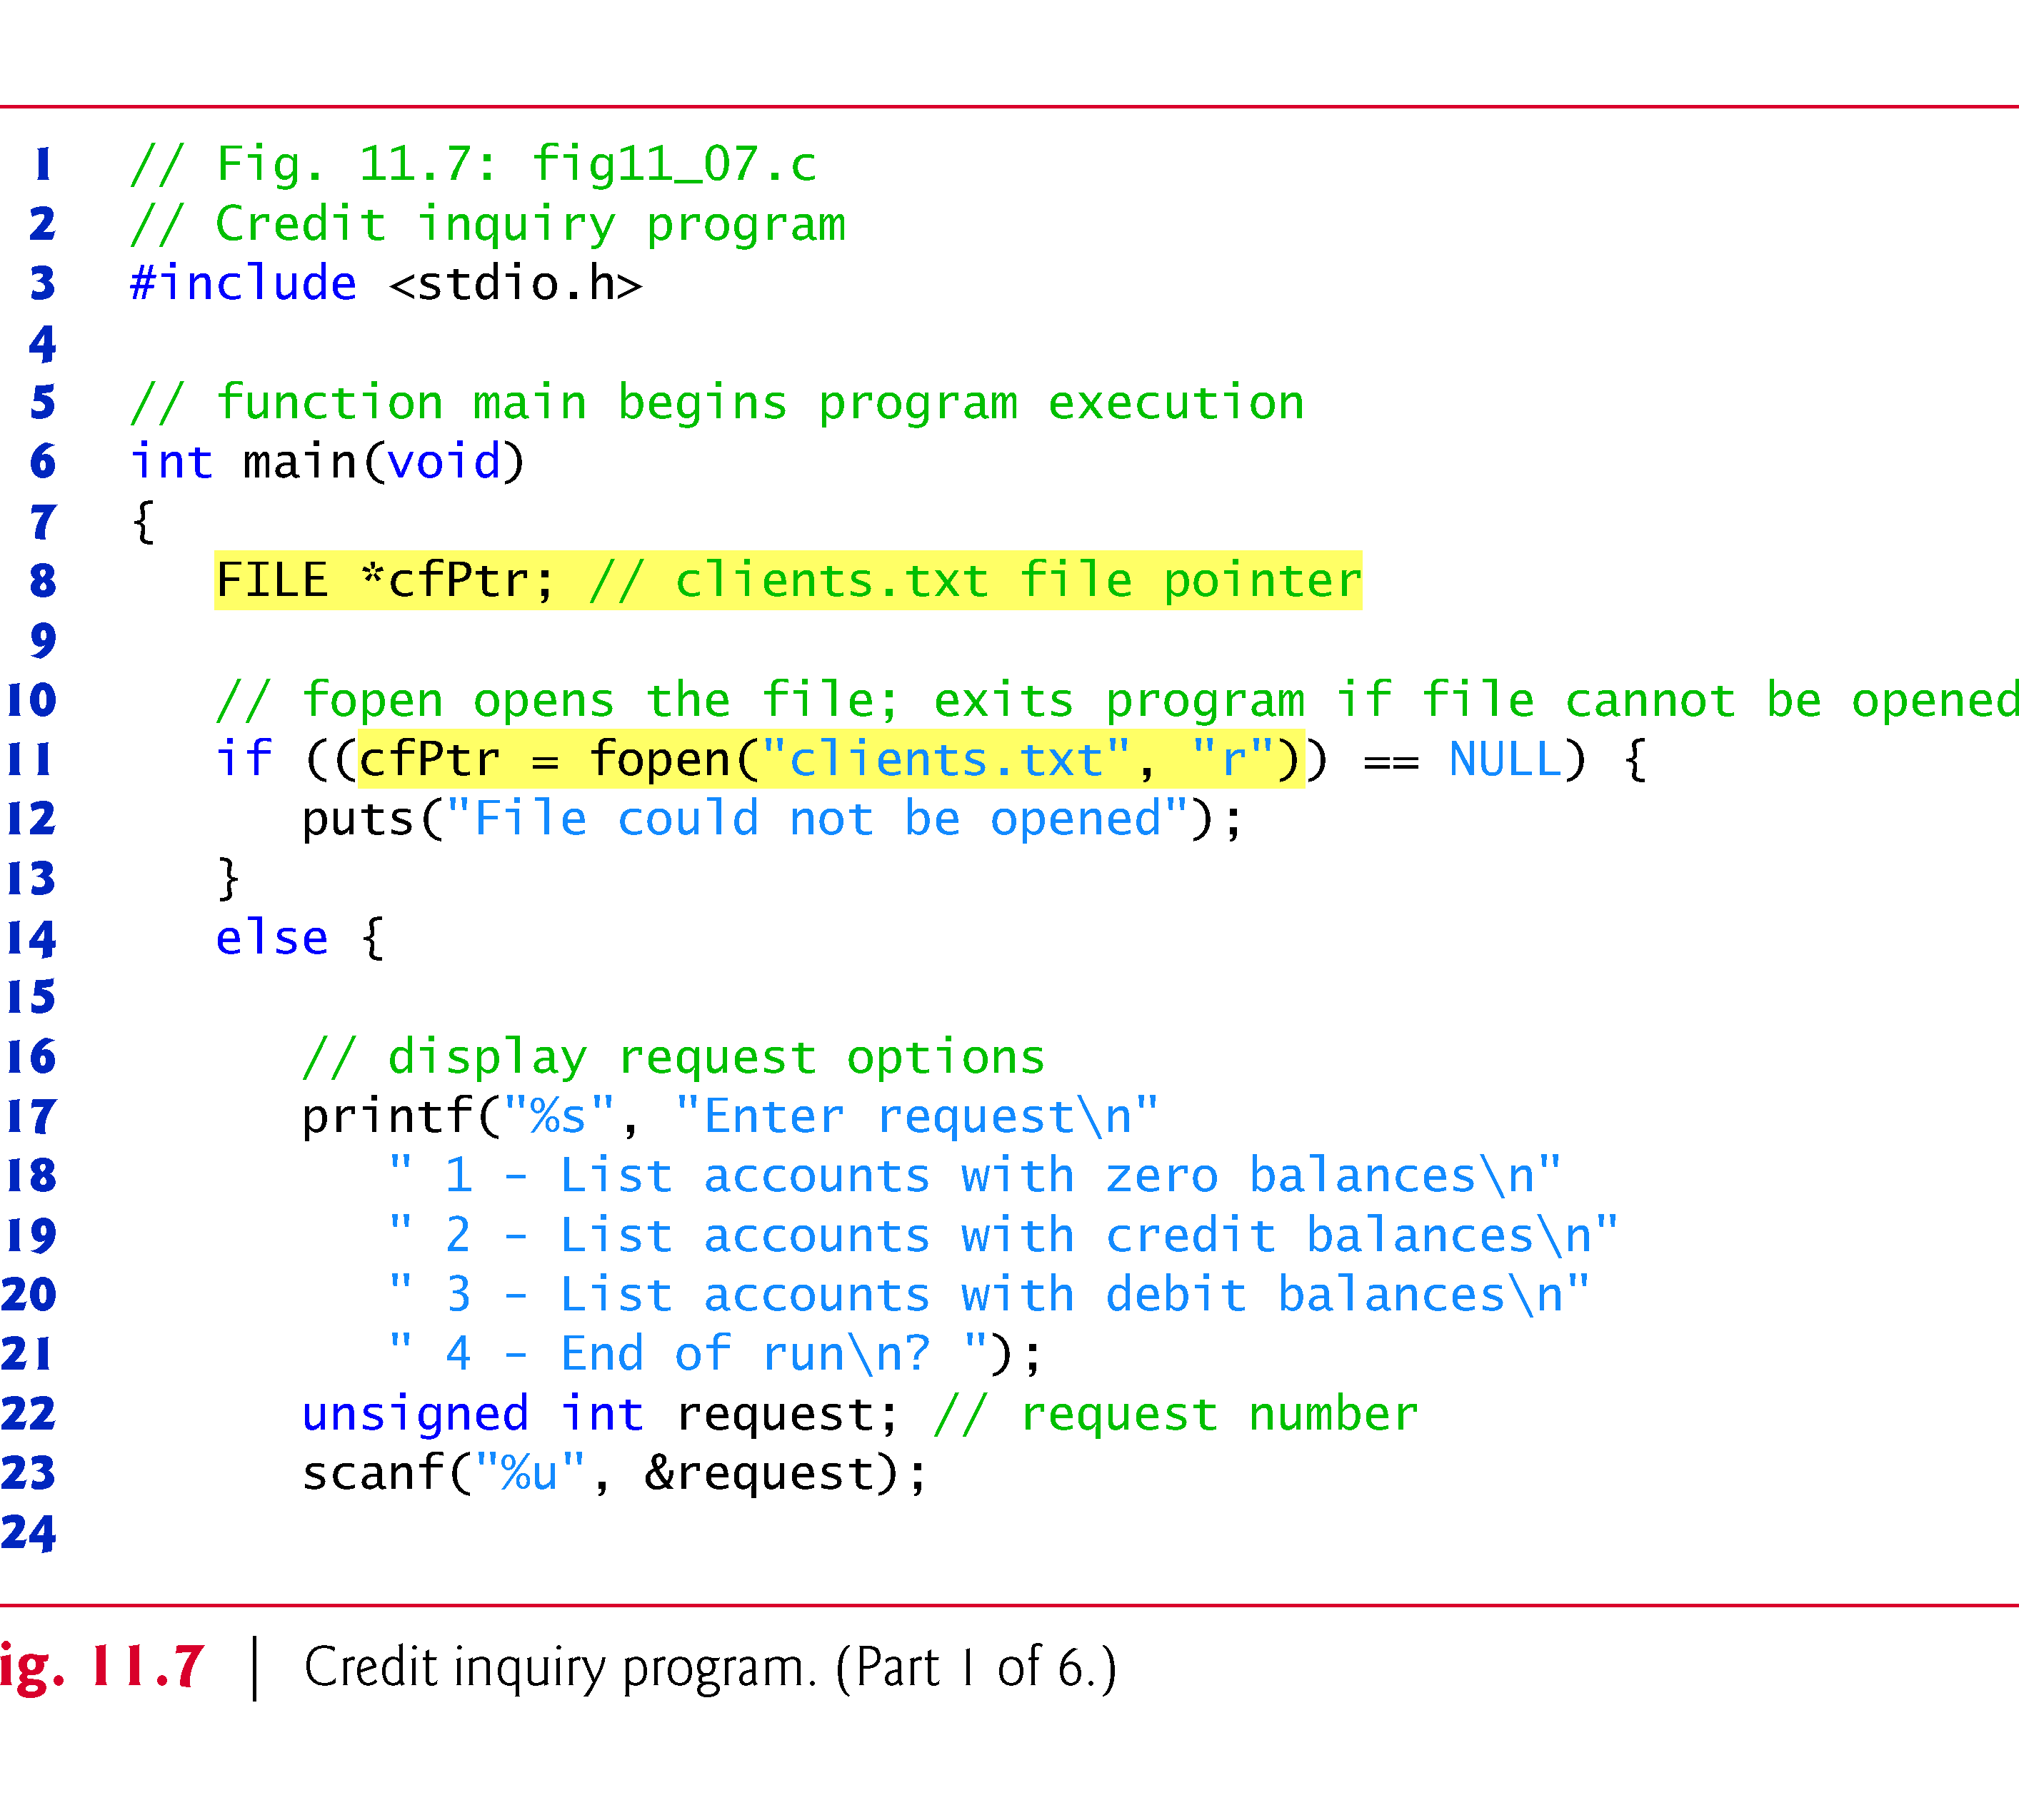
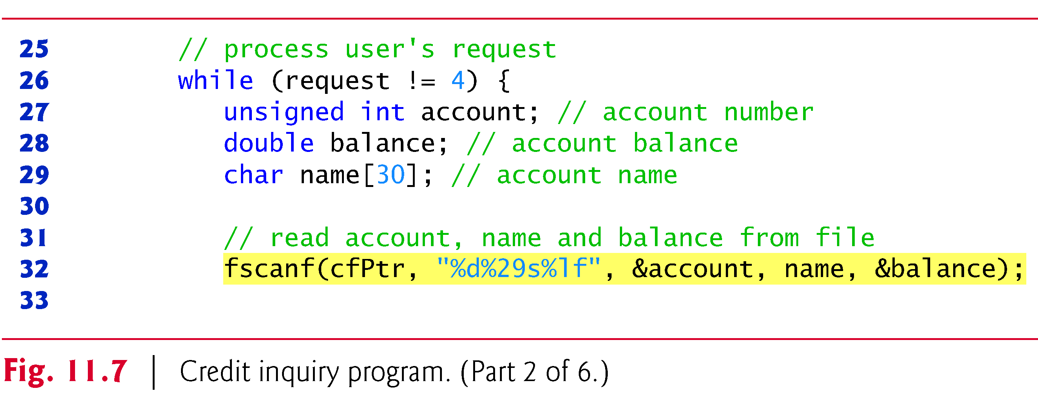

Slide 19
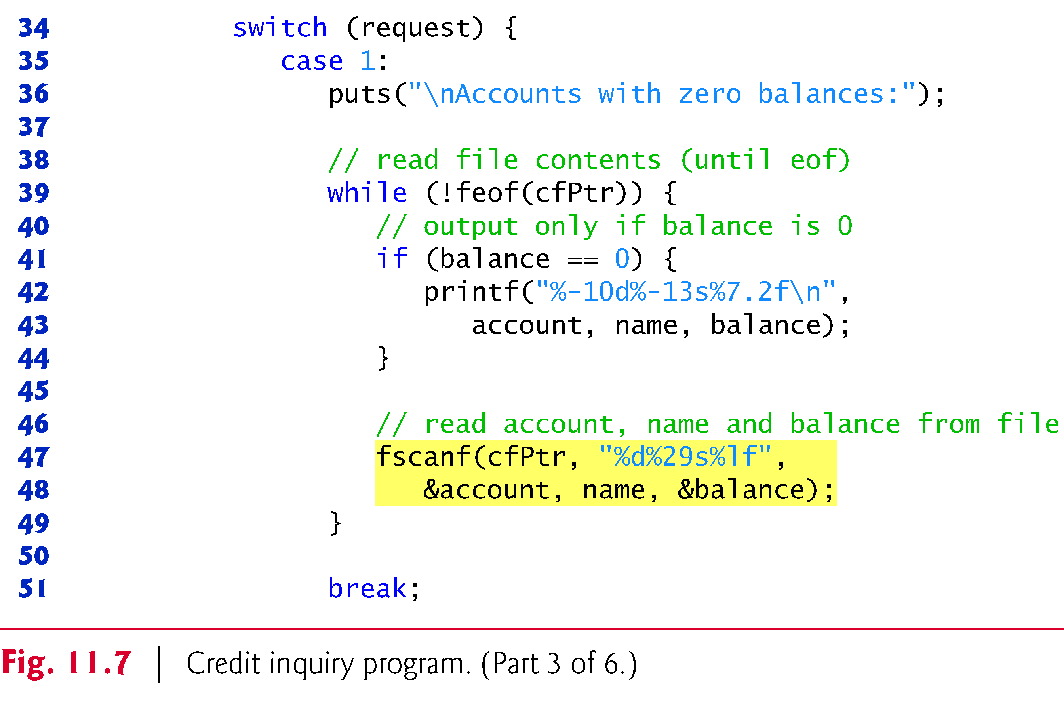
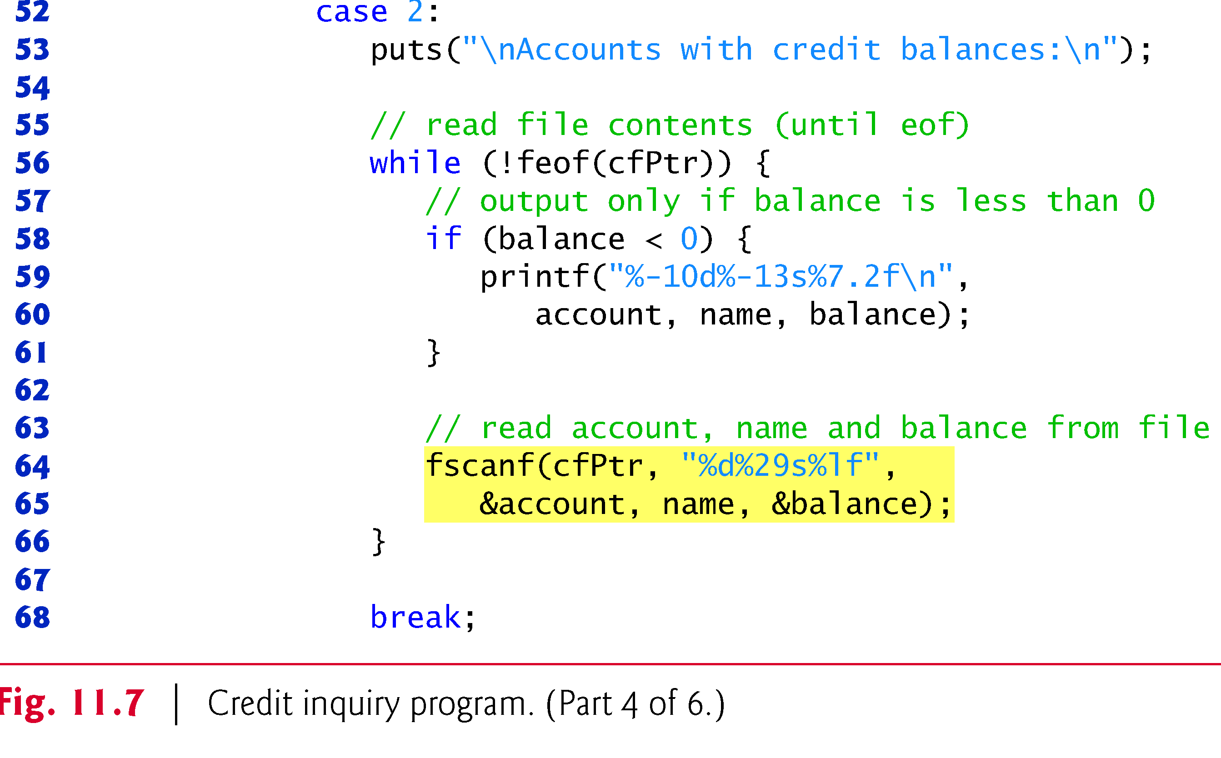

Slide 20
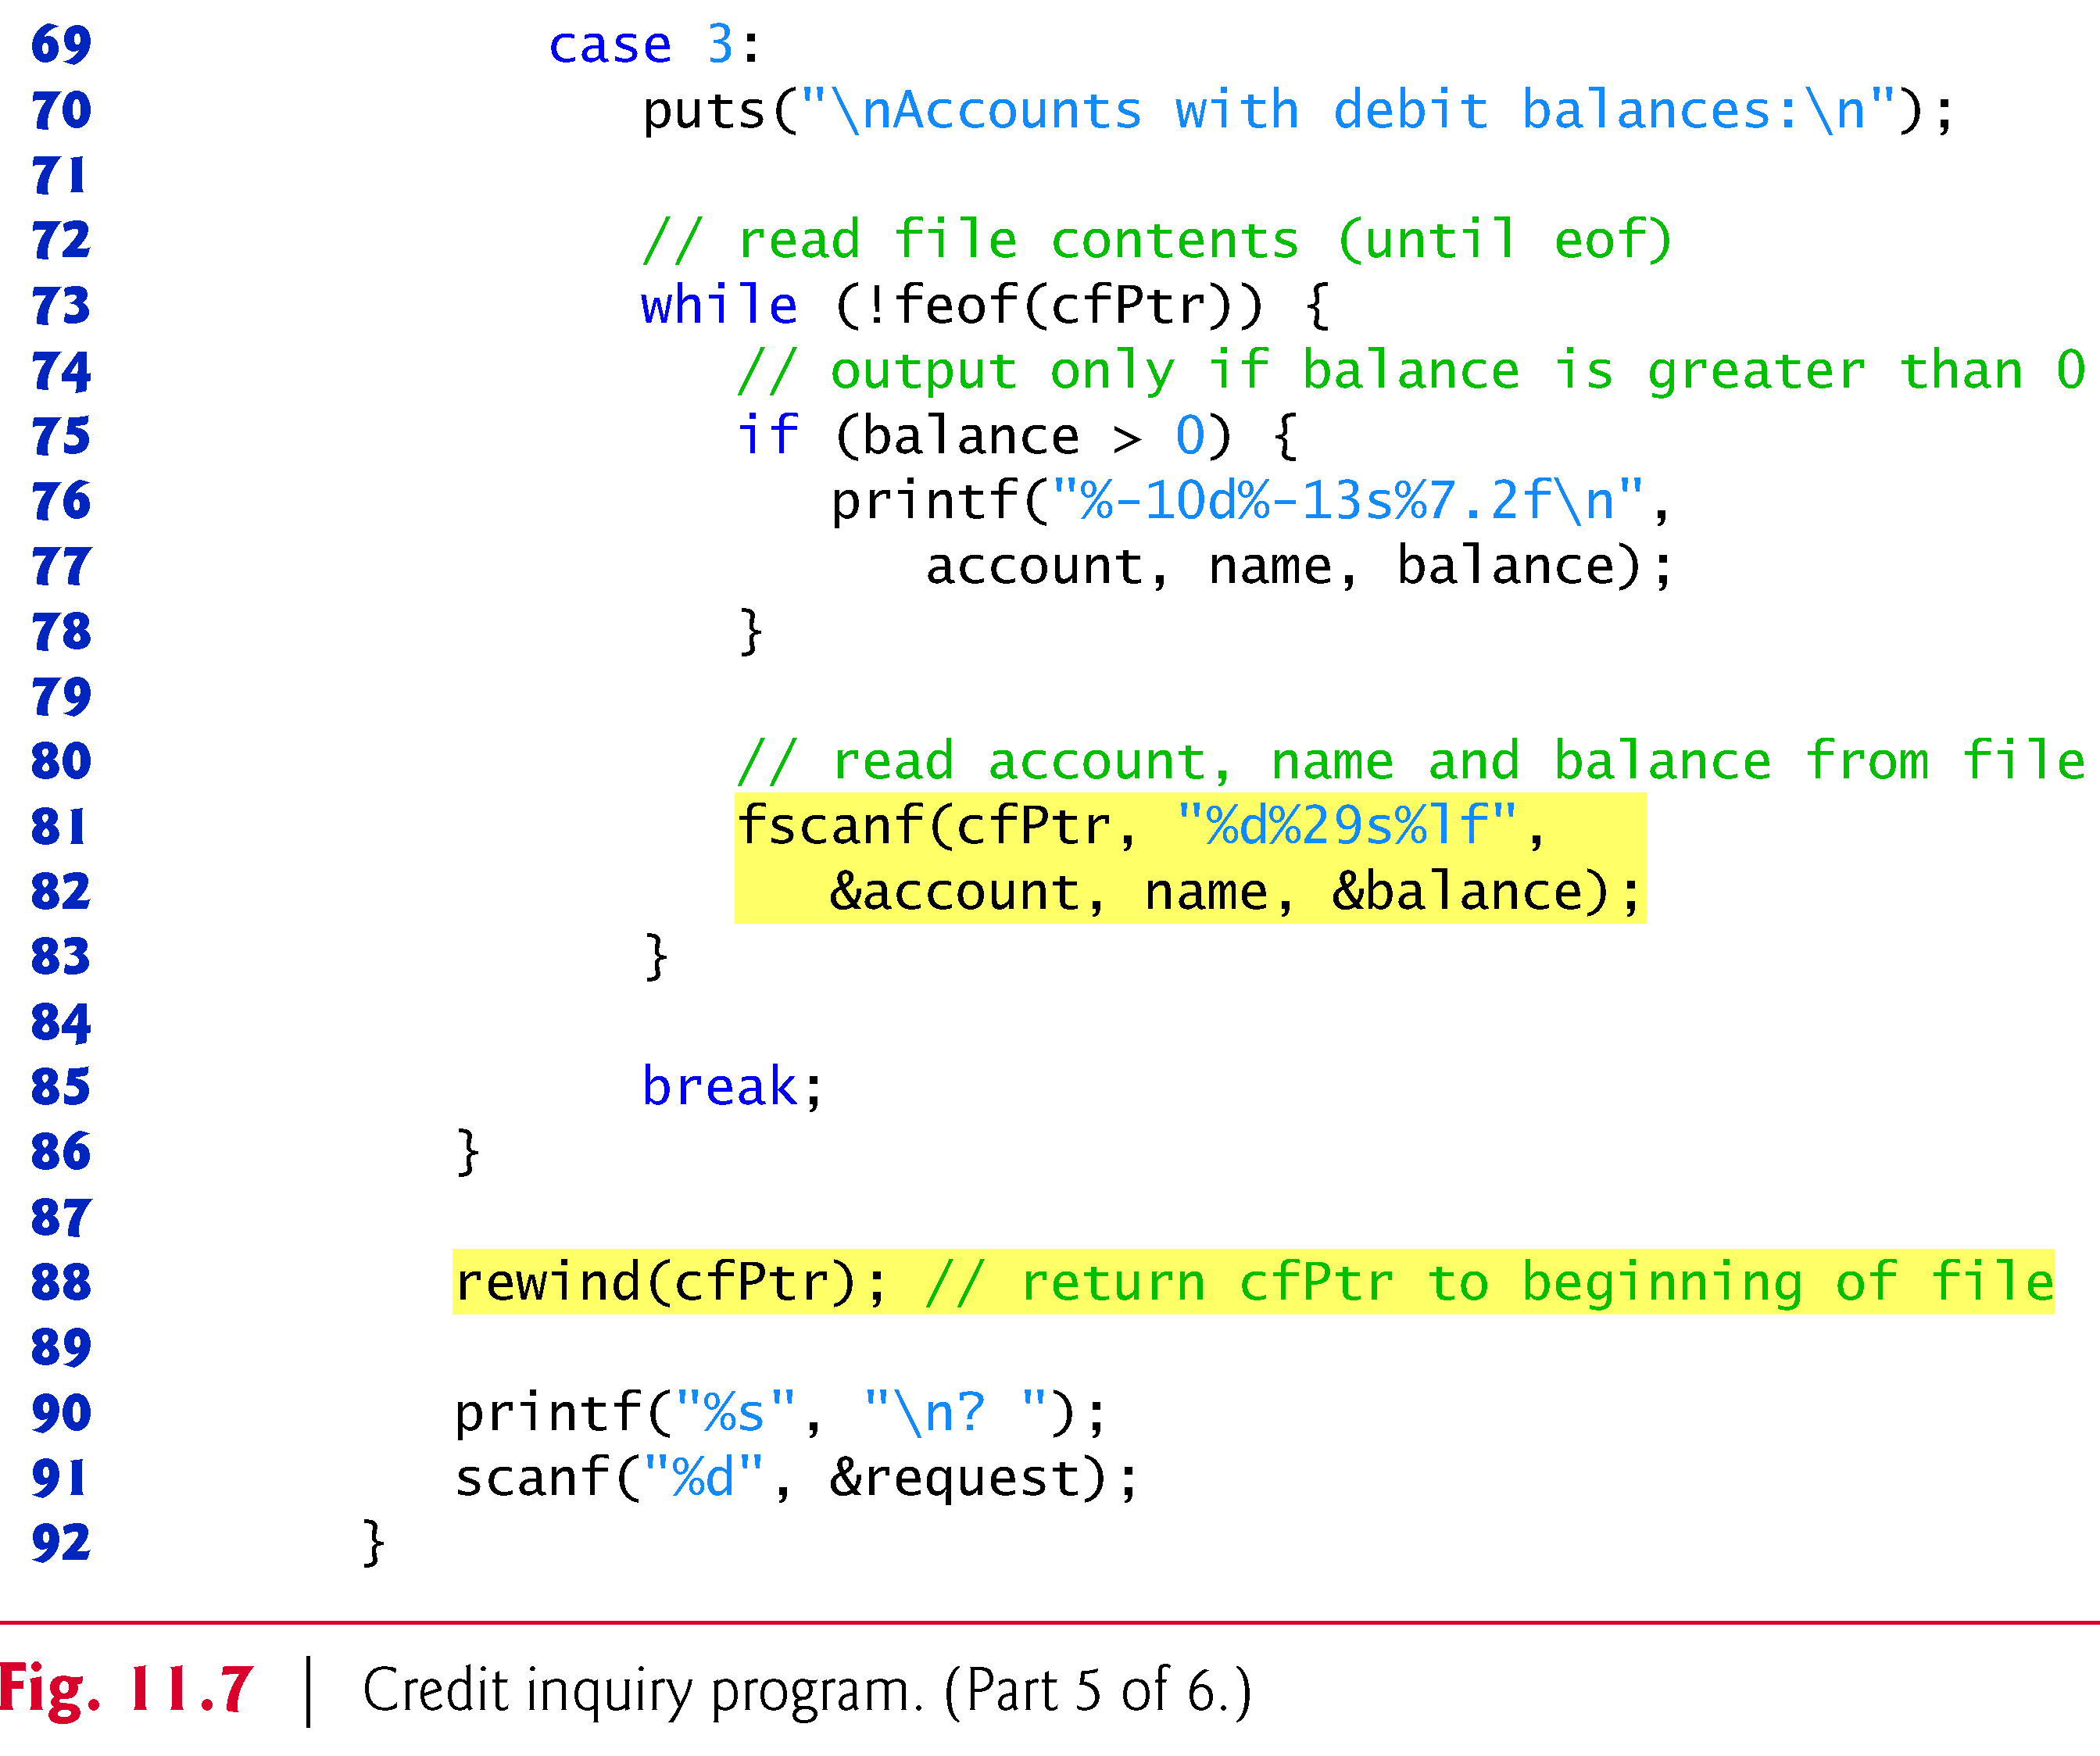
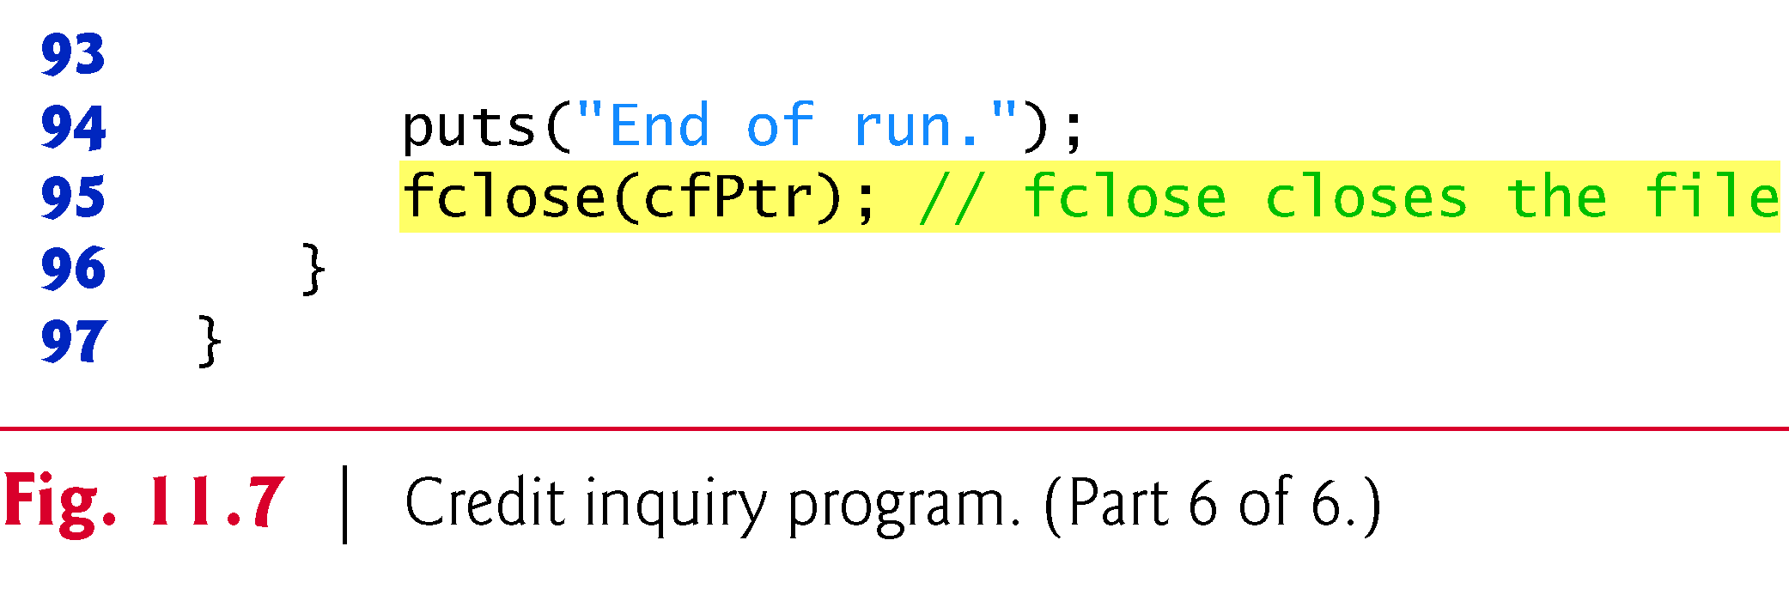

Slide 21
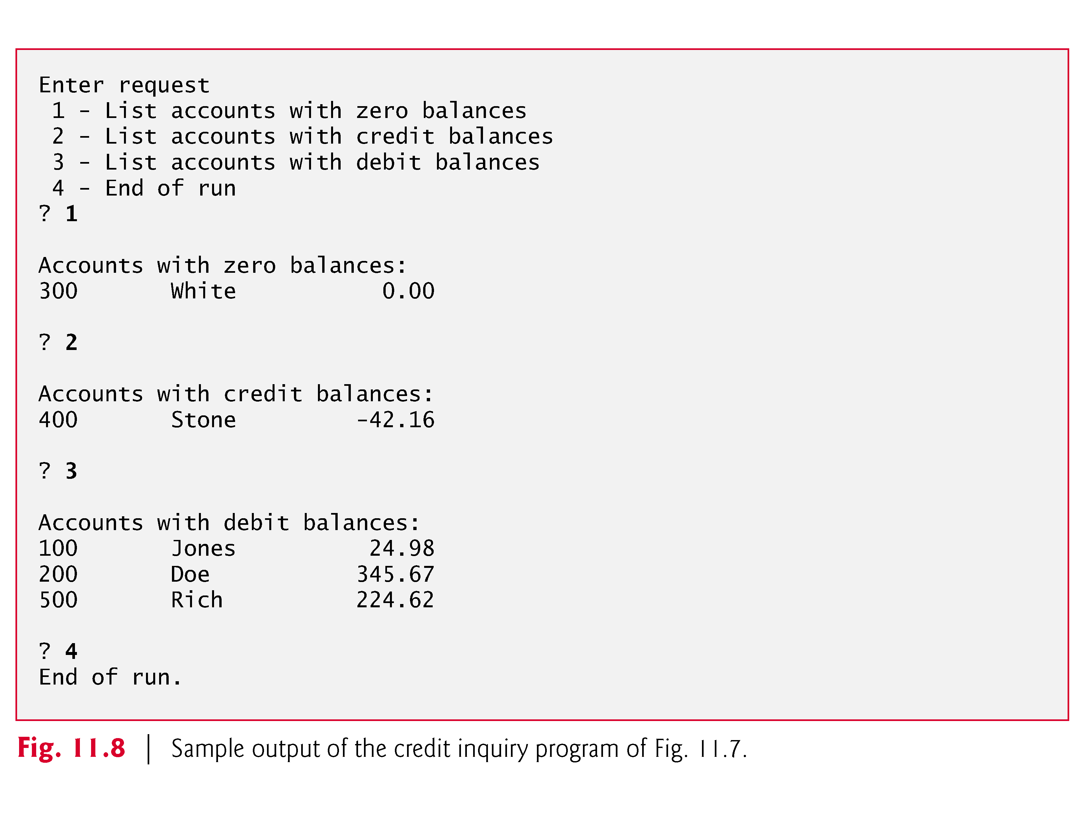

Slide 22
Reading Data from a Sequential Access File
Sequential access file
Cannot be modified without the risk of destroying other data
Fields can vary in size
Different representation in files and screen than internal representation
1, 34, -890 are all ints, but have different sizes on disk
300 White 0.00 400 Jones 32.87 (old data in file)
If we want to change White's name to Worthington,
300 Worthington 0.00
300 White 0.00 400 Jones 32.87
Data gets overwritten
300 Worthington 0.00ones 32.87

Slide 23
Random-Access Files
Random access files
Access individual records without searching through other records
Instant access to records in a file
Data can be inserted without destroying other data
Data previously stored can be updated or deleted without overwriting
Implemented using fixed length records
Sequential files do not have fixed length records

Slide 24
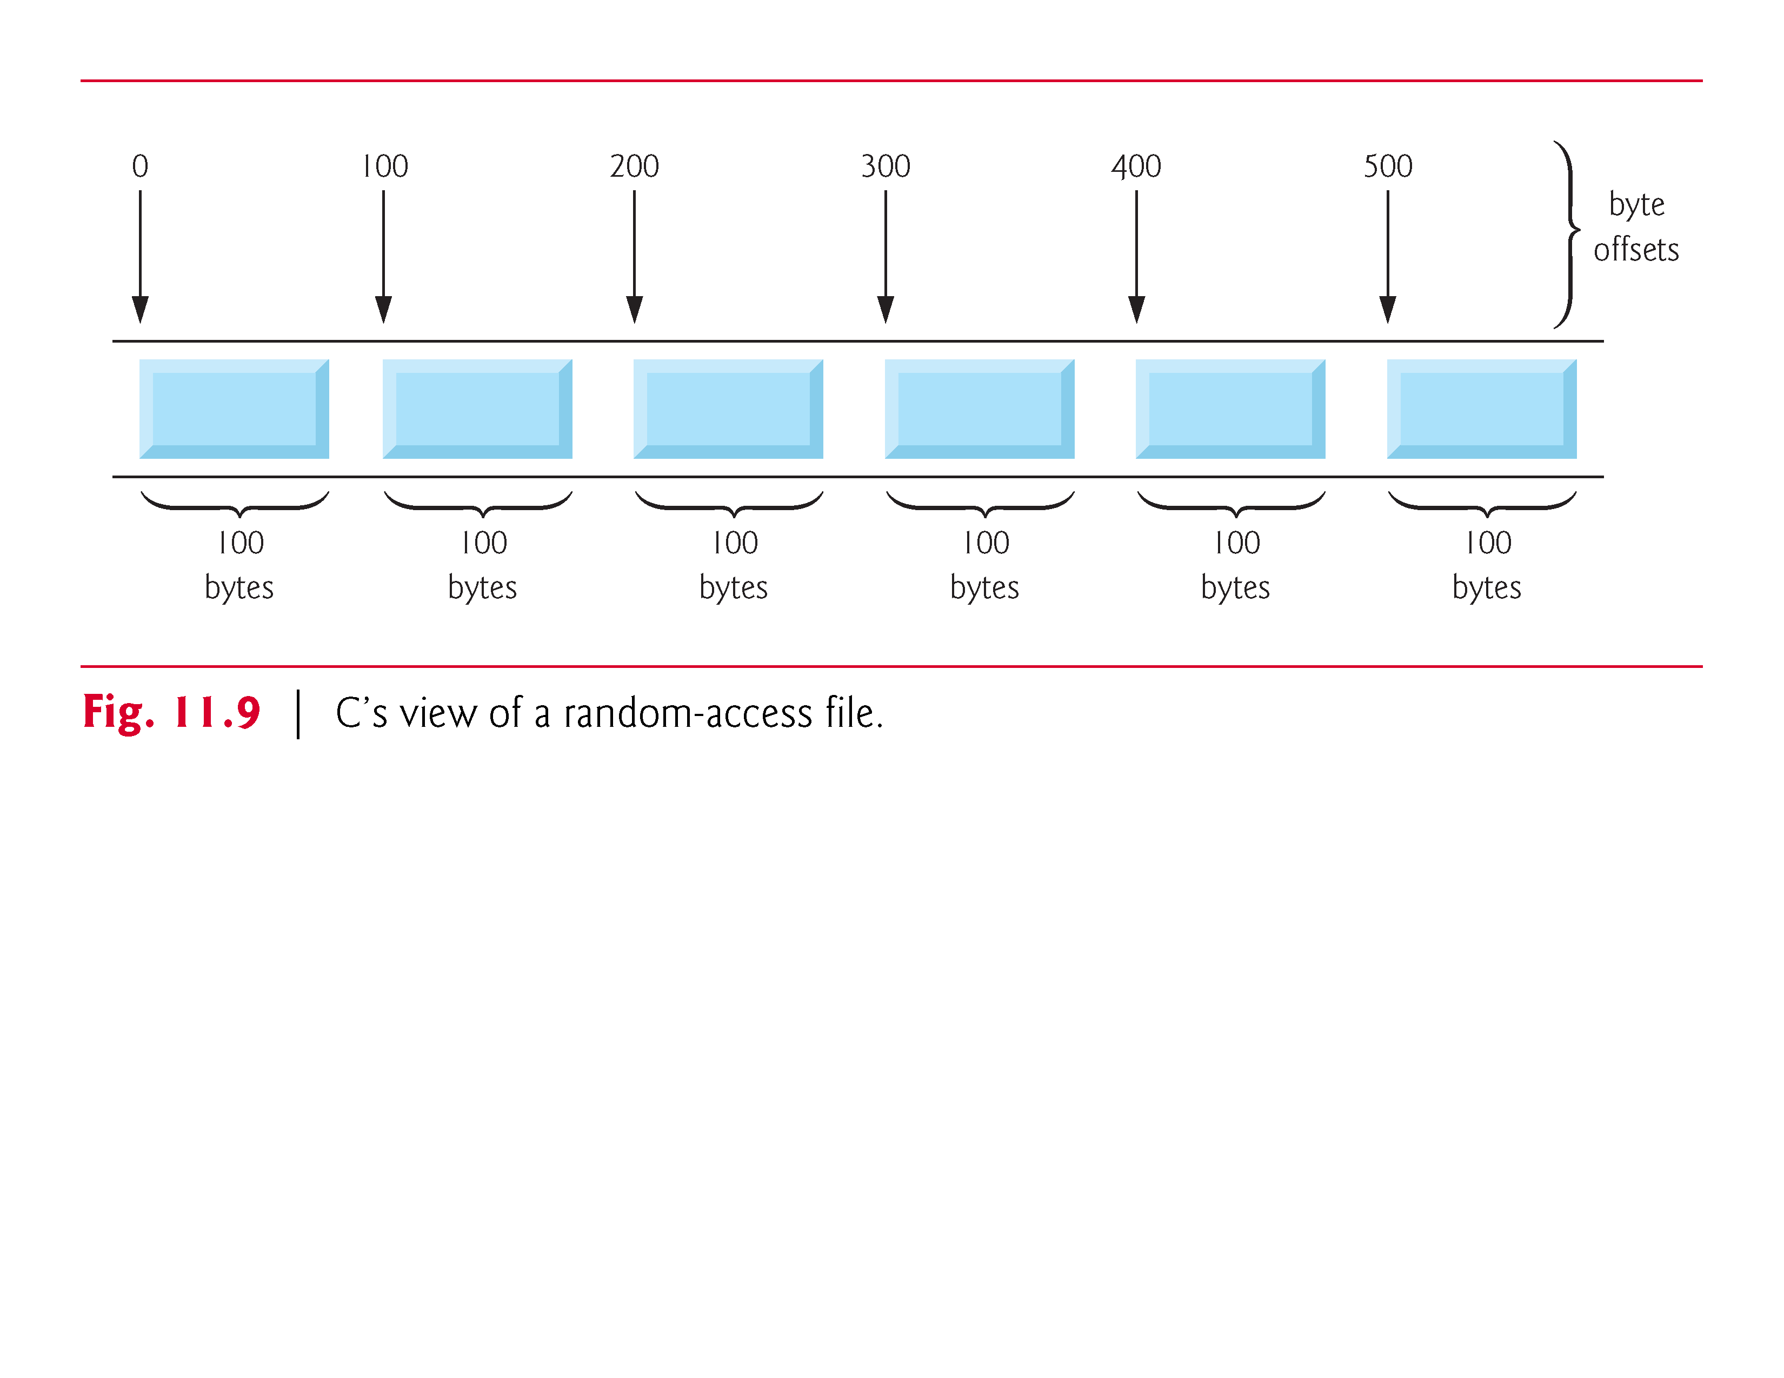

Slide 25
Creating a Randomly Accessed File
Data in random access files
Unformatted (stored as "raw bytes")
All data of the same type (ints, for example) uses the same amount of memory
All records of the same type have a fixed length
Data not human readable

Slide 26
Creating a Randomly Accessed File
Unformatted I/O functions
fwrite
Transfer bytes from a location in memory to a file
fread
Transfer bytes from a file to a location in memory
Example:
fwrite( &number, sizeof( int ), 1, myPtr );
&number – Location to transfer bytes from
sizeof( int ) – Number of bytes to transfer
1 – For arrays, number of elements to transfer
In this case, "one element" of an array is being transferred
myPtr – File to transfer to or from

Slide 27
Creating a Randomly Accessed File
Writing structs
fwrite( &myObject, sizeof (struct myStruct), 1, myPtr );
sizeof – returns size in bytes of object in parentheses
To write several array elements
Pointer to array as first argument
Number of elements to write as third argument

Slide 28
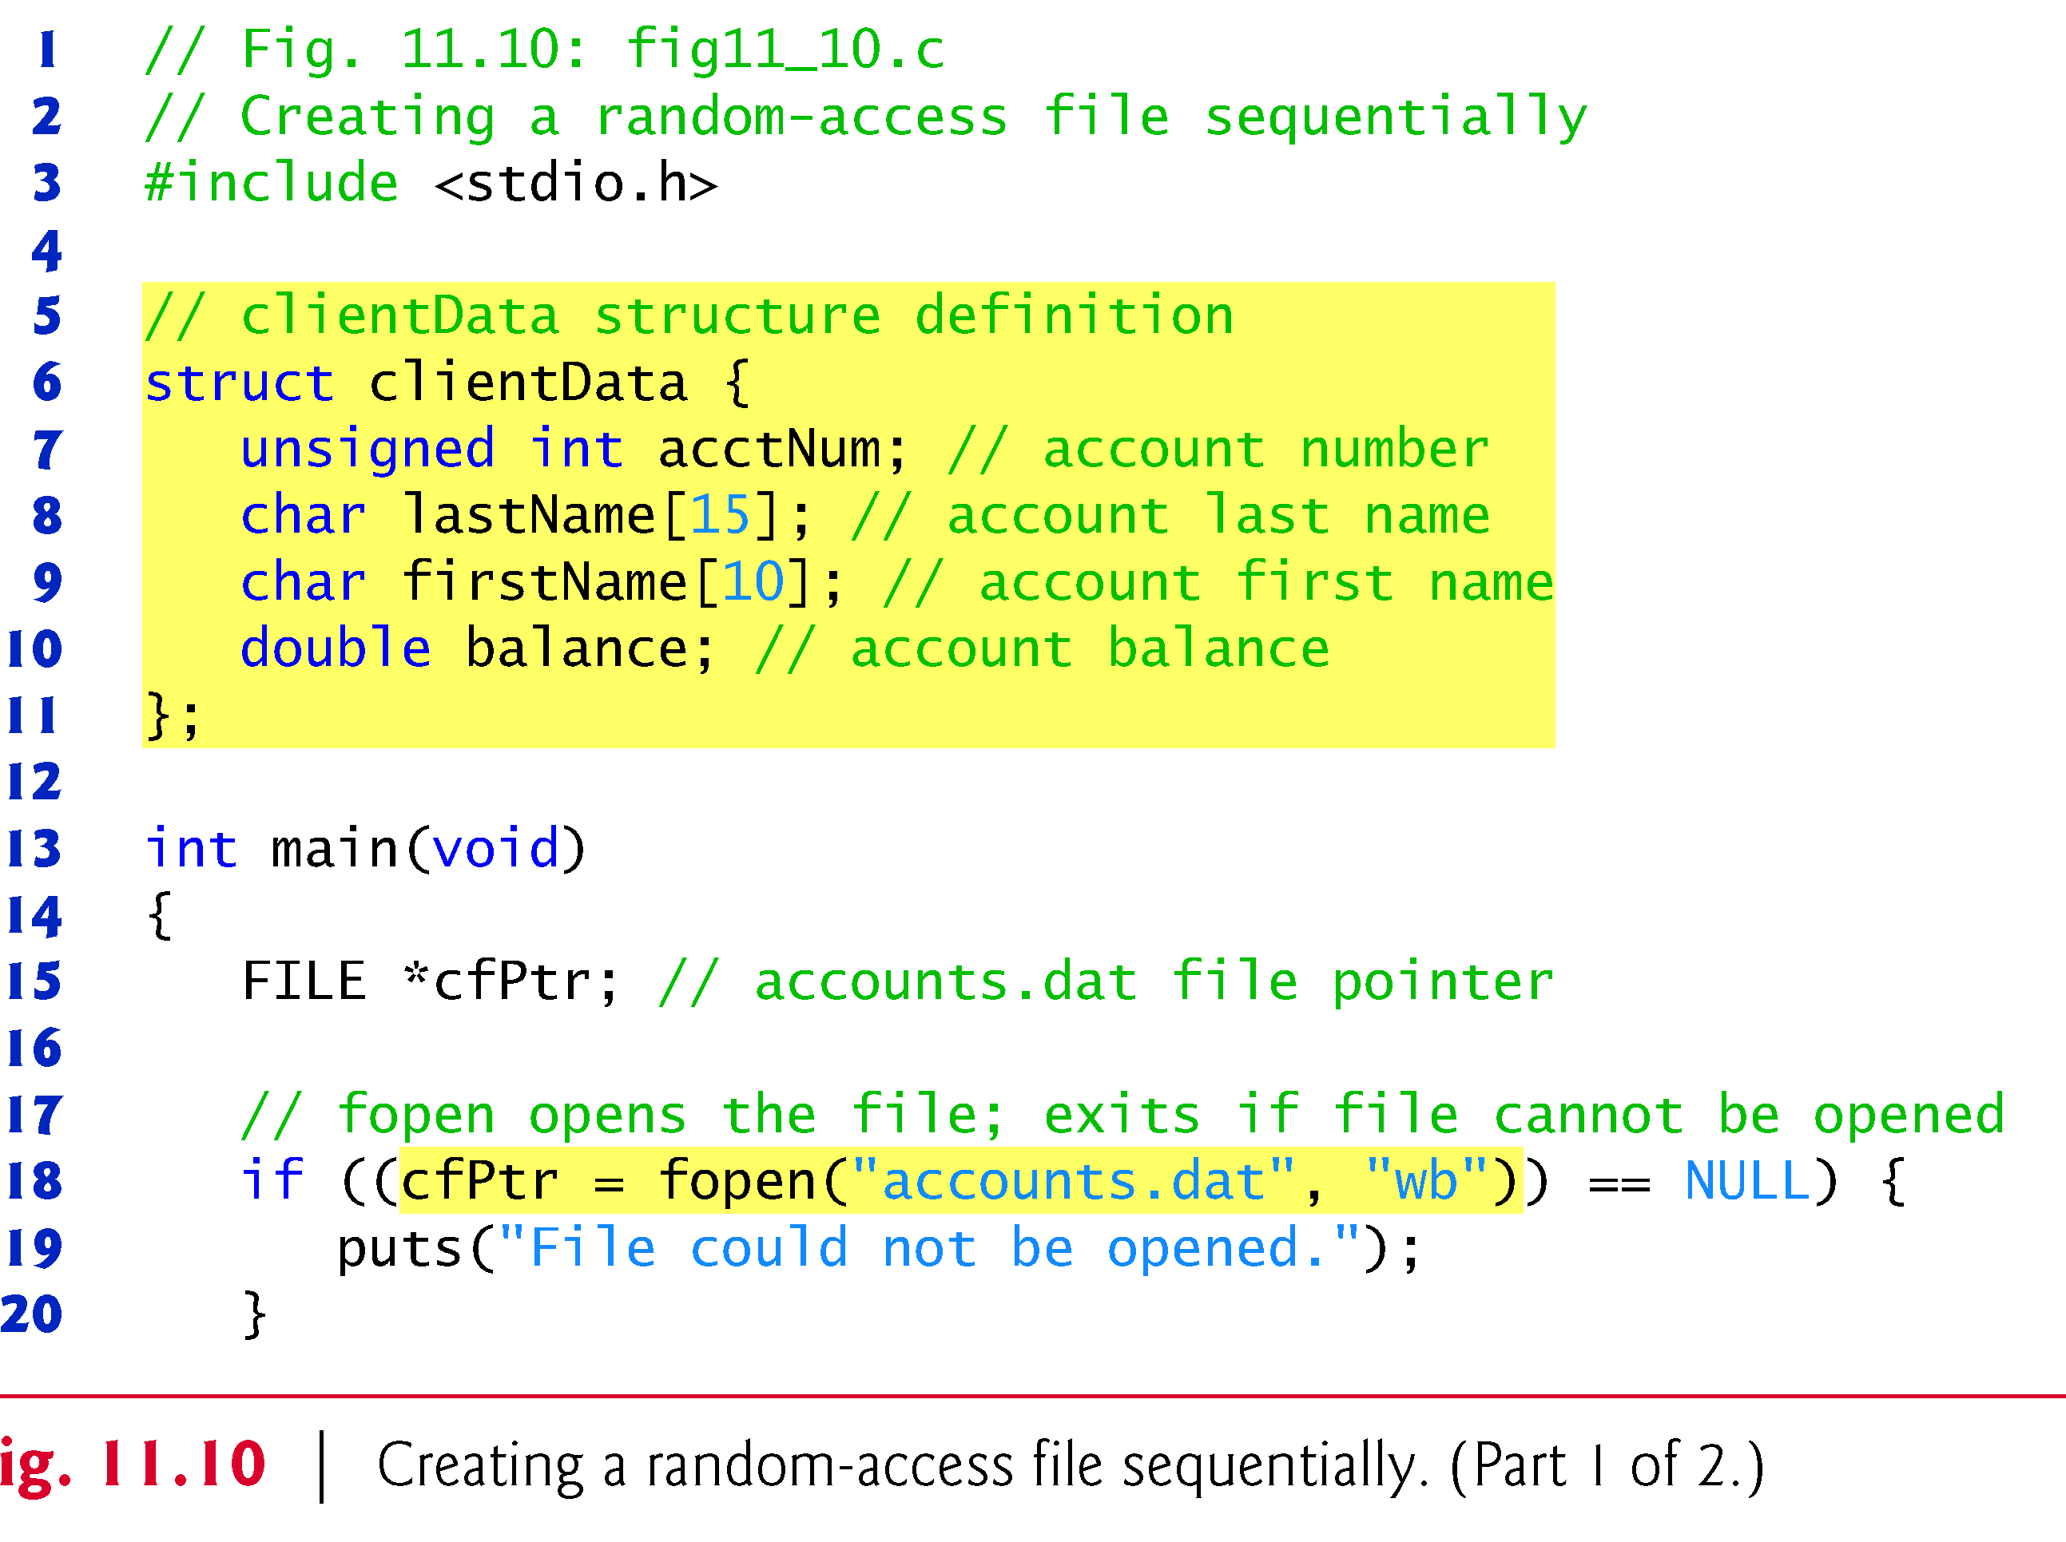
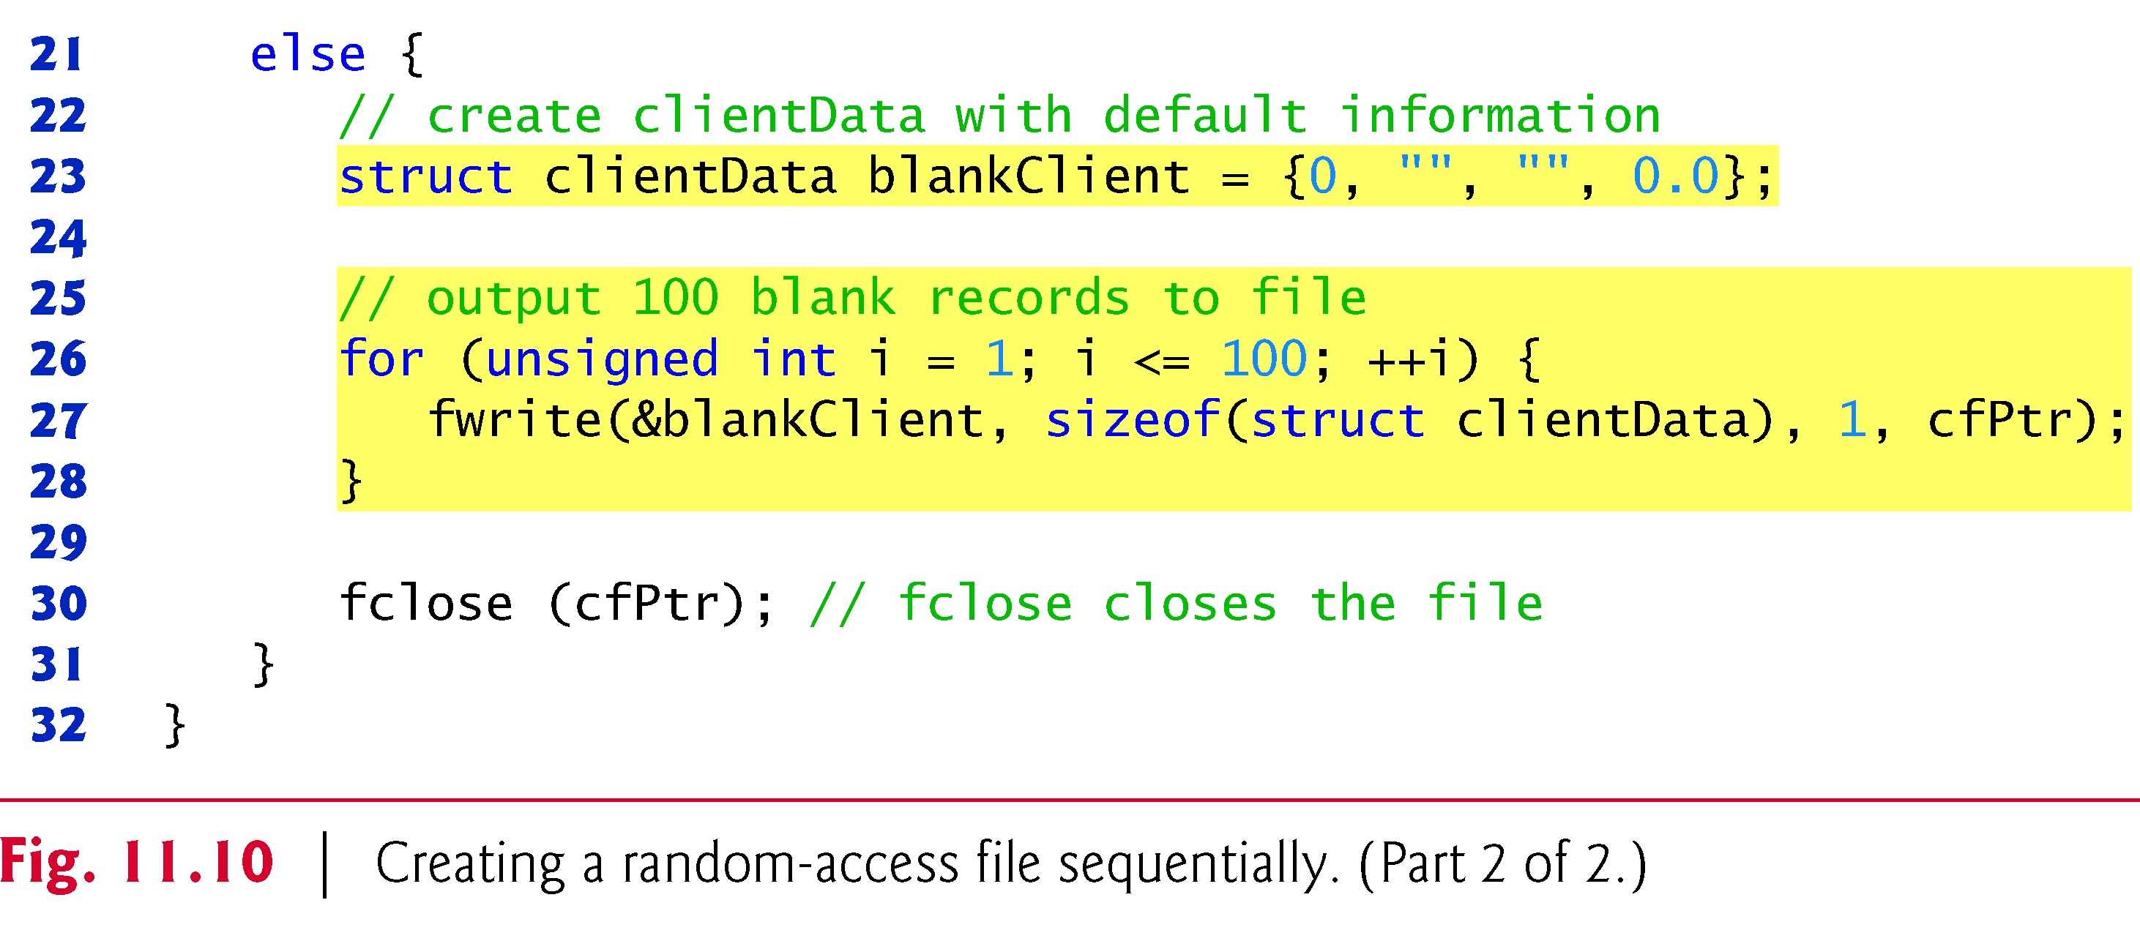

Slide 29
Writing Data Randomly to a Randomly Accessed File
fseek
Sets file position pointer to a specific position
fseek( pointer, offset, symbolic_constant );
pointer – pointer to file
offset – file position pointer (0 is first location)
symbolic_constant – specifies where in file we are reading from
SEEK_SET – seek starts at beginning of file
SEEK_CUR – seek starts at current location in file
SEEK_END – seek starts at end of file

Slide 30
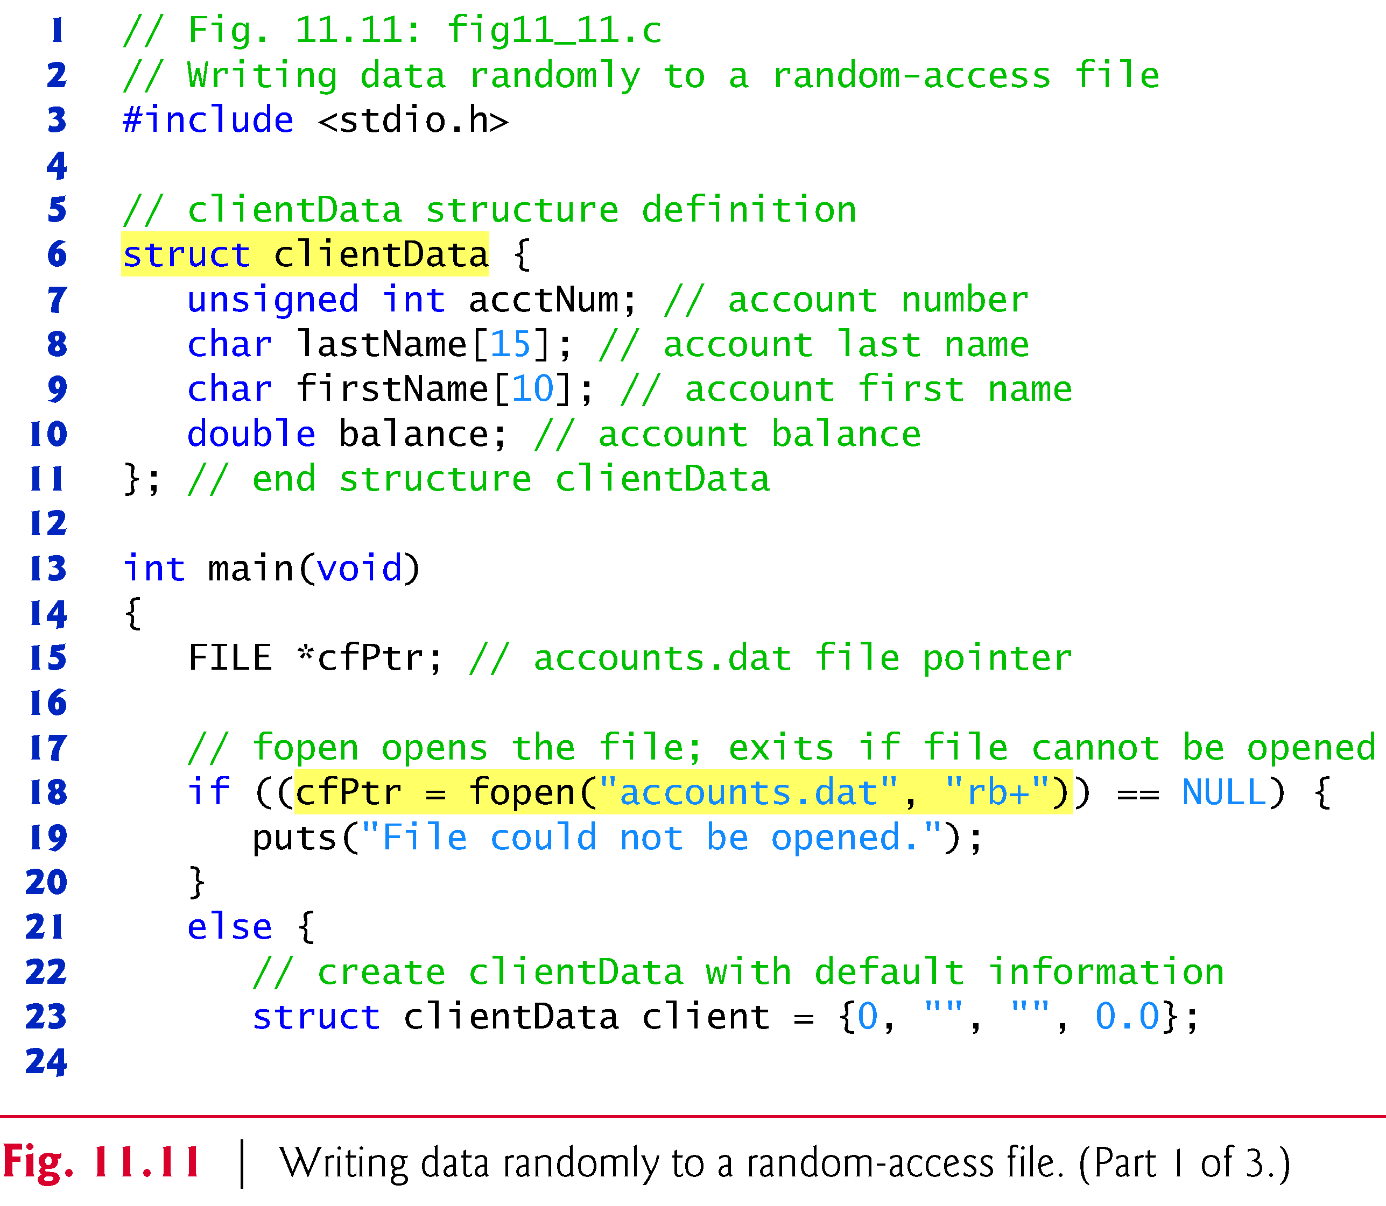
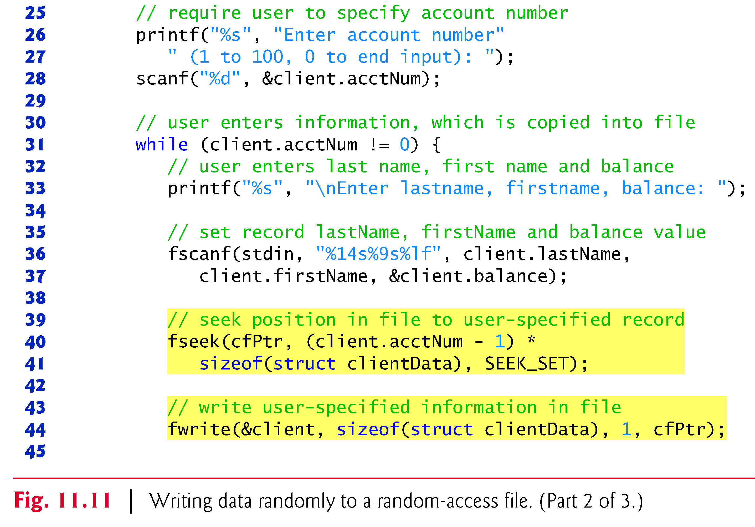

Slide 31
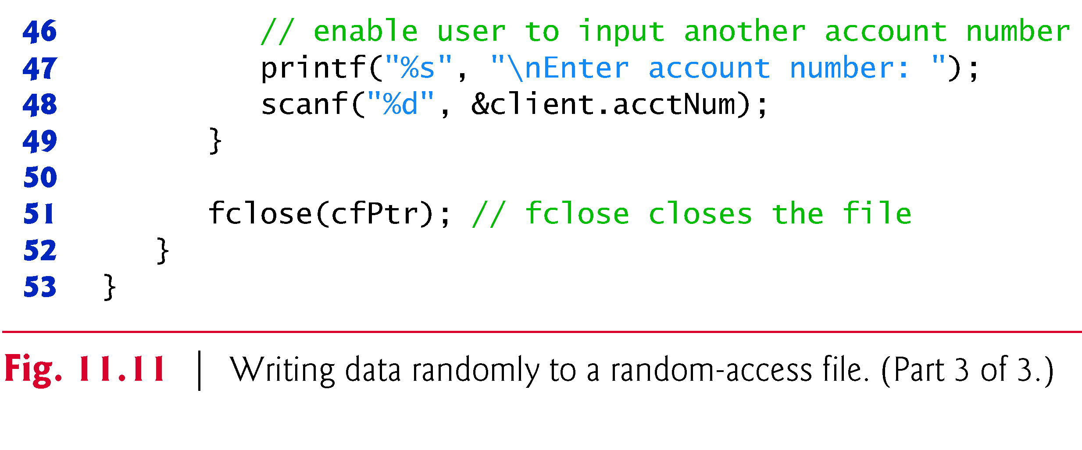
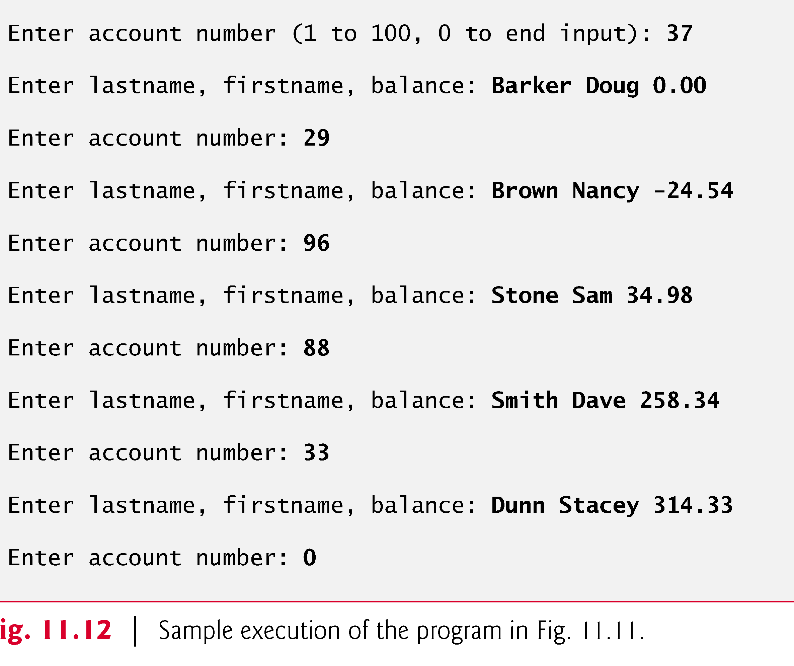

Slide 32
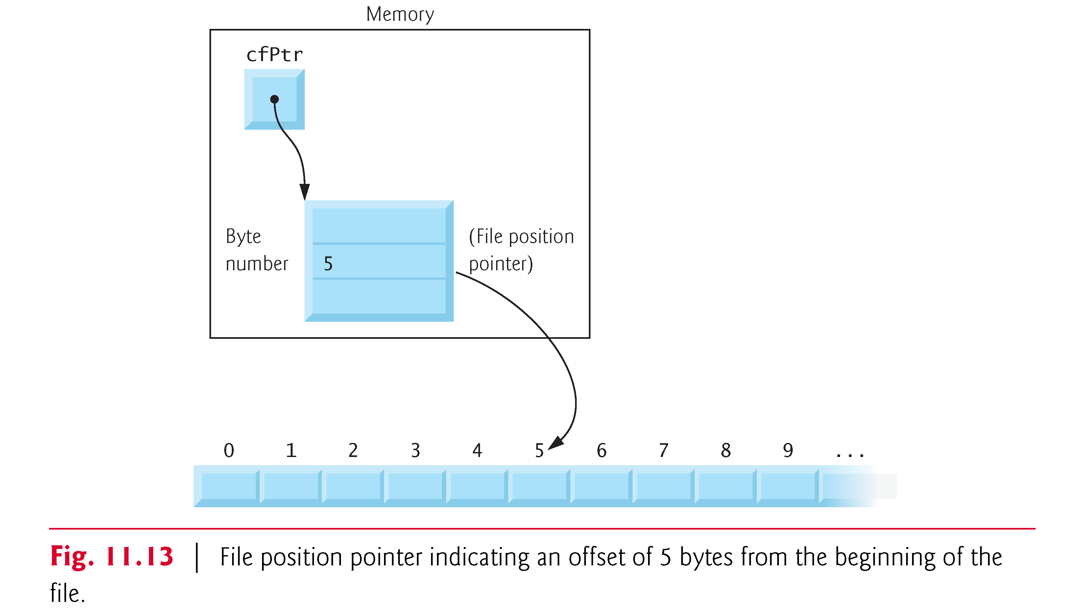
Writing Data Randomly to a Randomly Accessed File

Slide 33
Reading Data Randomly from a Randomly Accessed File
fread
Reads a specified number of bytes from a file into memory
fread( &client, sizeof (struct clientData), 1, myPtr );
Can read several fixed-size array elements
Provide pointer to array
Indicate number of elements to read
To read multiple elements, specify in third argument

Slide 34
fig11_15.c (1 of 2)

Slide 35
fig11_15.c (2 of 2)

Slide 36
Acct Last Name First Name Balance
29 Brown Nancy -24.54
33 Dunn Stacey 314.33
37 Barker Doug 0.00
88 Smith Dave 258.34
96 Stone Sam 34.98
Program Output

Slide 37
Case Study: A Transaction Processing Program
This program
Demonstrates using random access files to achieve instant access processing of a bank’s account information
We will
Update existing accounts
Add new accounts
Delete accounts
Store a formatted listing of all accounts in a text file

Slide 38
fig11_16.c (1 of 11)

Slide 39
fig11_16.c (2 of 11)

Slide 40
fig11_16.c (3 of 11)

Slide 41
fig11_16.c (4 of 11)

Slide 42
fig11_16.c (5 of 11)

Slide 43
fig11_16.c (6 of 11)

Slide 44
fig11_16.c (7 of 11)

Slide 45
fig11_16.c (8 of 11)

Slide 46
fig11_16.c (9 of 11)

Slide 47
fig11_16.c (10 of 11)

Slide 48
fig11_16.c (11 of 11)

Slide 49
After choosing option 1 accounts.txt contains:
Acct Last Name First Name Balance
29 Brown Nancy -24.54
33 Dunn Stacey 314.33
37 Barker Doug 0.00
88 Smith Dave 258.34
96 Stone Sam 34.98
Program Output
After choosing option 2 accounts.txt contains:
Enter account to update ( 1 - 100 ): 37
37 Barker Doug 0.00
Enter charge ( + ) or payment ( - ): +87.99
37 Barker Doug 87.99
After choosing option 3 accounts.txt contains:
Enter new account number ( 1 - 100 ): 22
Enter lastname, firstname, balance
? Johnston Sarah 247.45

